Slide 1

An Introduction to Multi-armed Bandit
Qing Wang, AI & Deep Learning team of GCDO
Some slides from Li Zhou and Jure Leskovec
Notes:
Hi everyone. My name is Qing Wang. I’m a data scientist of AI and Deep Learning team of GCDO. Today I’m going to introduce you a very simple but powerful online decision-making model, it is called multi-armed bandit.

Slide 2


AGENDA
Motivation
Background & Problem Formulation
Bandit Models
Results
Question
Notes:
This is the agenda of the talk. I will give you some motivation first why we interest in this model, and then introduce the background and the problem itself. And then some popular bandit models and results to show its model’s performance on personalized recommendation.

Slide 3

Motivation

Slide 4
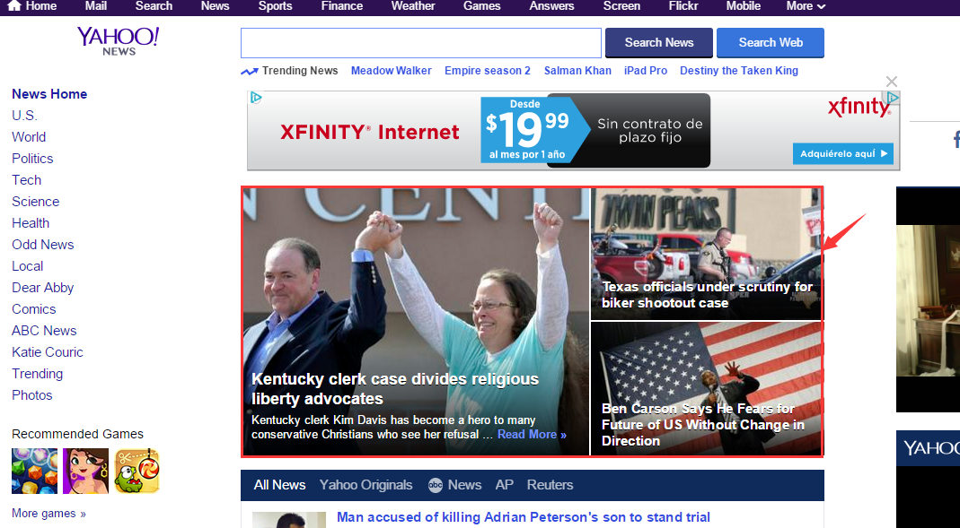
What is news personalization?
Customize news feed based on users’ interests.
Particularly, Cold Start problem: How to personalize news for a new user?
Goal: Maximize user engagement
Notes:
Before we get into this machine learning model, I’d like to state a problem close to our daily life, so we can better understand what bandits are useful for, and how we can apply them in our projects.
The figure shows a personalized news recommendation system. In this system, it recommends users news based on their interests to maximize the user’s engagement (for example, click through rate)
So, it needs to design an algorithm to learn each user’s interests to find out their interested news. The traditional approach is to use a machine learning technique called collaborative filtering. This method can achieve a good performance, but it is an offline model which means it cannot learn from the experiences (e.g., user’s feedback of each recommended news) in real time and it fails the cold start problem: do a recommendation for a new user. Now let’s look at how the bandit model solve these problems.

Slide 5

Multi-armed Bandit for News Recommendation
Take personalized news recommendation as an example
There are a bunch of articles in the news pool
Users come sequentially and ready to be enter
News articles
Notes:
Different from the traditional recommendation models, Bandit model can learn user interests online through user’s feedback. We take the personalized news recommendation as an example. We have a bunch of news in the news pool, and users visit the system sequentially.

Slide 6
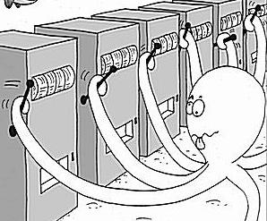
Multi-armed Bandit for News Recommendation
At each time, we want to select one article for a user
article 1
User 1
news articles
Like it?
Multi-armed Bandit
Notes:
At each time, the bandit model selects one article for the user from the news pool.

Slide 7

Multi-armed Bandit for News Recommendation
Goal: maximize CRT(click through rate)
Not really!
article 1
User 1
news articles
Like it?
Multi-armed Bandit
Notes:
But the user doesn’t like the recommended article and we get the negative feedback from the user.

Slide 8
Multi-armed Bandit for News Recommendation
Update the model with user’s feedback
Not really!
article 1
User 1
news articles
feedback
Like it?
Multi-armed Bandit
Notes:
The negative feedback will be fed to the bandit model, and the model will be updated.

Slide 9
Multi-armed Bandit for News Recommendation
Update the model once the user gives the feedback
Yeah!
article 2
User 1
news articles
Like it?
Multi-armed Bandit
Notes:
The model recommends another article with the highest probability that user will like it.

Slide 10

Multi-armed Bandit for News Recommendation
Update the model once the user gives the feedback
Yeah!
article 2
User 1
news articles
feedback
Like it?
How about article 3,4,5…?
Multi-armed Bandit
Notes:
At this time, the user likes it and give the positive feedback to the bandit model. Now you should realize that bandit model is similar to reinforcement learning models. Yes, it is one simple model of reinforcement learning.

Slide 11
Notes:
Let’s continue to learn more about the multi-armed bandit problem.

Slide 12
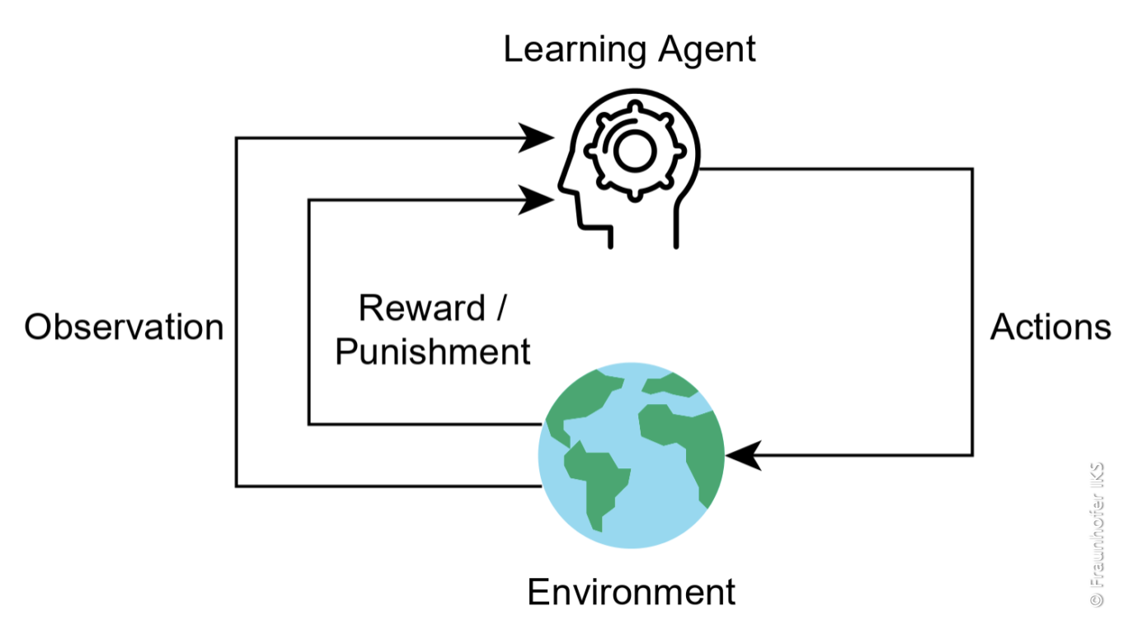
Reinforcement Learning
Notes:
Reinforcement learning problem is one of the most popular machine learning topics. It is a problem of getting a learning agent to act in the world in order to maximize its rewards. The learner interacts dynamically with its environment moves from one state to another, rewards are given based on the actions taken by the learner. The guidelines for which action to take in each state is called ‘policy’. So reinforcement learning methods try to efficiently find an optimal policy to maximized the cumulative rewards.

Slide 13
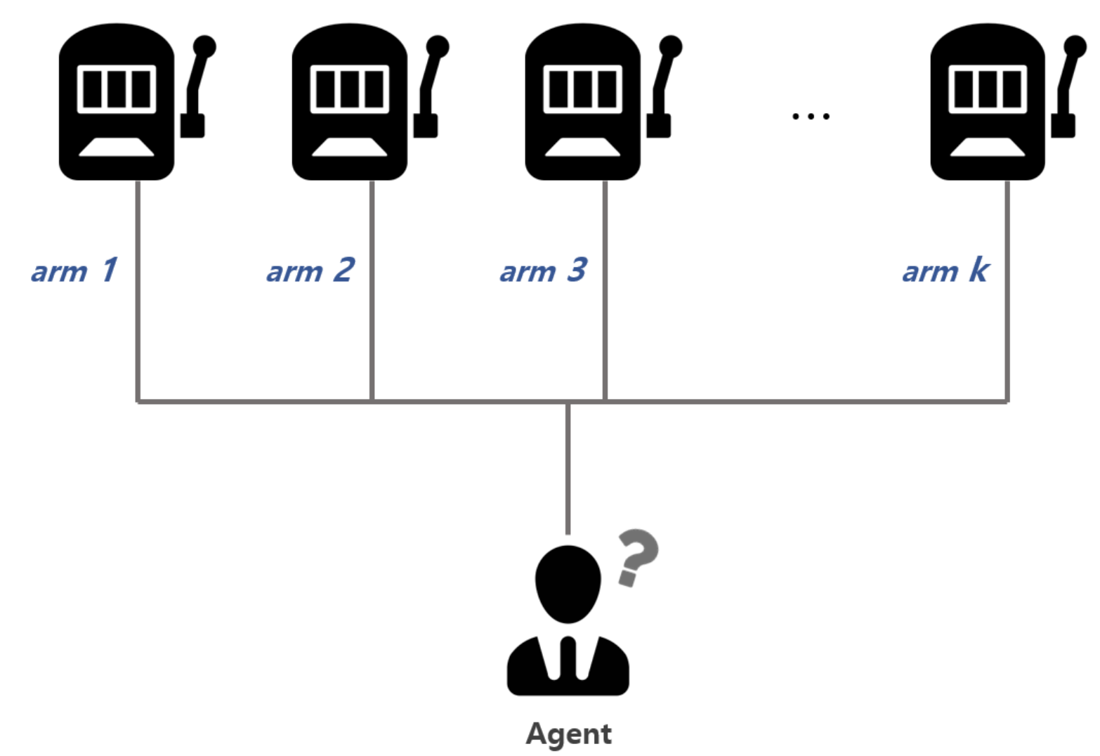
Multi-armed Bandit Definition
The MAB problem is a classical paradigm in Machine Learning in which an online algorithm choses from a set of strategies in a sequence of trials so as to maximize the total payoff of the chosen strategies[1].
reward 1
reward 2
reward 4
rewardk
[1] http://research.microsoft.com/en-us/projects/bandits/
Notes:
The bandit model is a subset of reinforcement learning. I give you the definition of bandit model here. It is an online decision-making algorithm that chooses from a set of strategies in a sequence of trials in order to maximize the total rewards of the chosen strategies.

Slide 14
Multi-armed Bandit Model
A gambler →casino
A row of slot machines providing random rewards
Only T trials.
Objective: Maximize the sum of rewards(Money)!
Notes:
This is a very classical usecase for bandit model. A gambler came into a casino and faces a row of slot machines, each slot machine provides random reward. And the gambler has only T times to play the slot machine.
The problem is how to choose the slot machine at each trial to maximize the total rewards in total T trials.
The bandit model can solve this problem properly.

Slide 15
Other Application
Clinical trials:
Investigate effects of different treatments while minimizing patient losses
Adaptive routing:
Minimize delay in the network by investigating different routes
Web advertising
Notes:
And other application for bandit model, Clinical trials, web advertising.

Slide 16
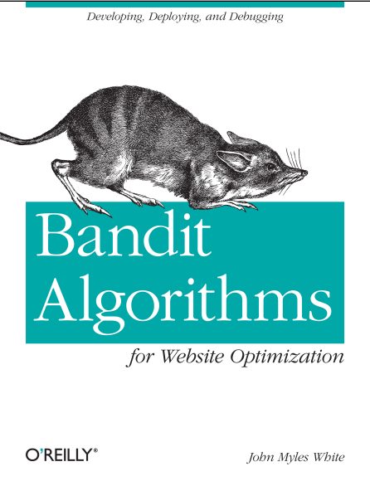
Some Jargon Terms
Arm: one idea/strategy
Bandit: A group of ideas(strategies)
Pull/Play/Trial: One chance to try your strategy
Reward: The unit of success we measure after each pull
Regret: Performance Metric
[1] Bandit Algorithms for Website Optimization Developing, Deploying, and Debugging By John Myles White, O'Reilly Media,2012
Notes:
Before we go into the detail of the bandit model. I list some Jargon terms for the bandit model.

Slide 17
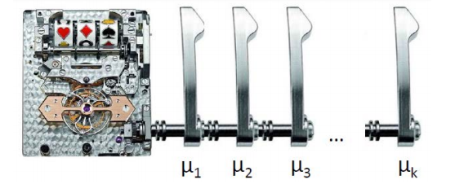
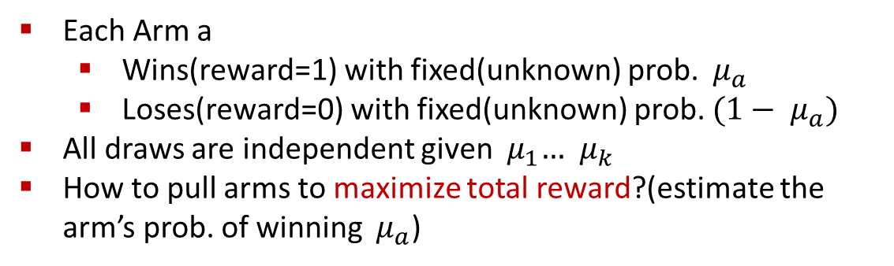
K-Armed Bandit
Each Arm a
Wins(reward=1) with fixed(unknown) prob. ${ μ}_{a}$
Loses(reward=0) with fixed(unknown) prob. ${(1− μ}_{a})$
All draws are independent given ${ μ}_{1}… { μ}_{k}$
How to pull arms to maximize total reward?(estimate the arm’s prob. of winning ${ μ}_{a}$)

Slide 18
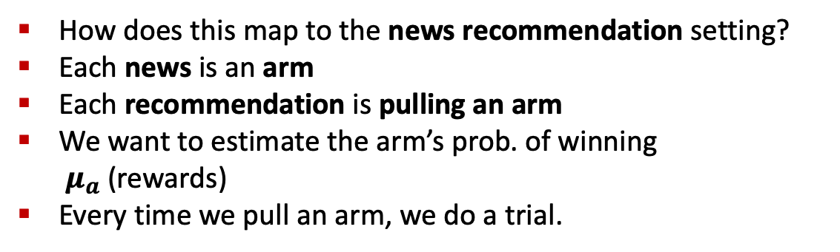
K-Armed Bandit
How does this map to the news recommendation setting?
Each news is an arm
Each recommendation is pulling an arm
We want to estimate the arm’s prob. of winning ${ μ}_{a}$(rewards)
Every time we pull an arm, we do a trial.

Slide 19
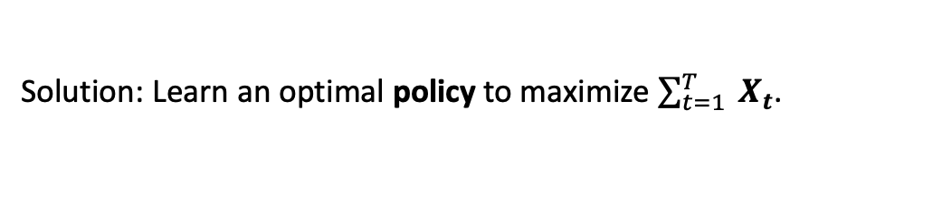
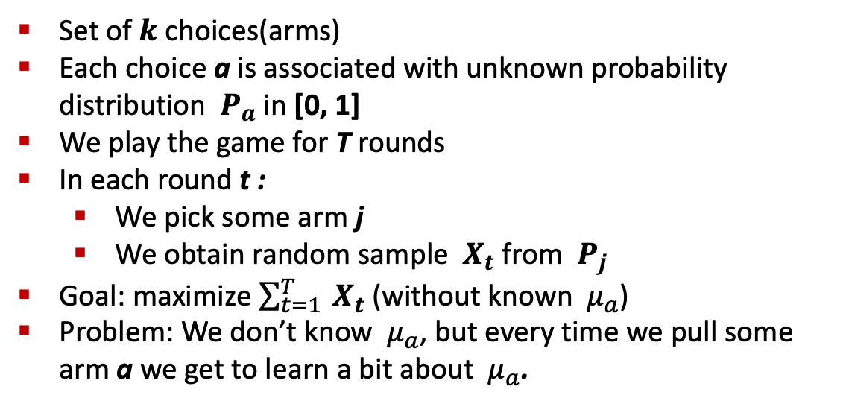
Stochastic K-Armed Bandit
The setting:
Set of $k$ choices(arms)
Each choice a is associated with unknown probability distribution ${ P}_{a}$ in [0, 1]
We play the game for T rounds
In each round t :
We pick some arm j
We obtain random sample ${ X}_{t}$ from ${ P}_{j}$
Goal: maximize $\sum_{t=1}^{T}{{ X}_{t}}$ (without known ${ μ}_{a}$)
Problem: We don’t know ${ μ}_{a}$, but every time we pull some arm a we get to learn a bit about ${ μ}_{a}$.
Solution: Learn an optimal policy to maximize $\sum_{t=1}^{T}{{ X}_{t}}$.
Notes:
This is the problem formulation of K-armed bandit model. It seems very complicated, but just remember our settings and the goals.

Slide 20
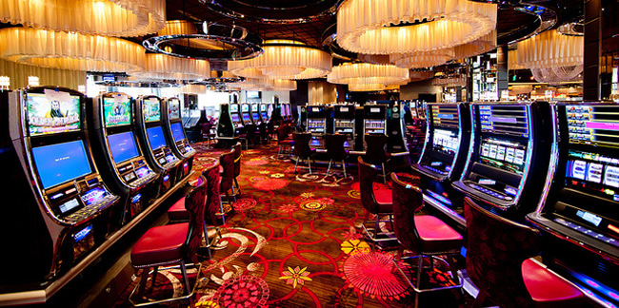
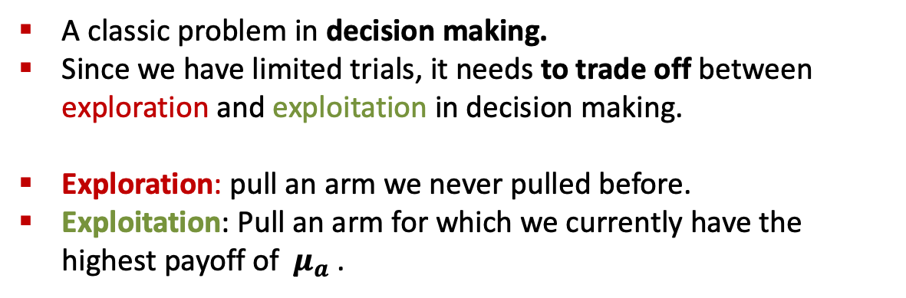
Exploration vs. Exploitation
A classic problem in decision making.
Since we have limited trials, it needs to trade off between exploration and exploitation in decision making.
Exploration: pull an arm we never pulled before.
Exploitation: Pull an arm for which we currently have the highest payoff of ${ μ}_{a}$.
Notes:
To solve the bandit problem is equal to make a good trade-off between exploration and exploitation in decision making.

Slide 21
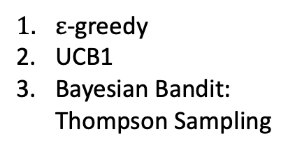
Bandit Algorithms to Explore-exploit Dilemma
Exploration
Tradeoff
Exploitation
K bandit algorithm
Contextual free
Contextual
$ε$-greedy
UCB1
Bayesian Bandit: Thompson Sampling
Ex3, Ex4
Thompson Sampling
LinUCB

Slide 22
Bandit Models

Slide 23
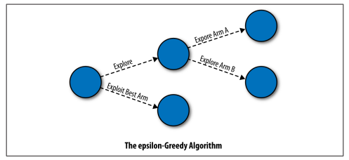
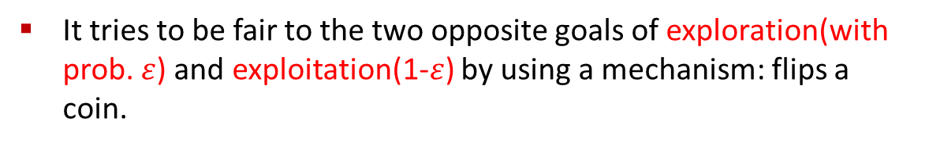

$ε$-Greedy Algorithm
It tries to be fair to the two opposite goals of exploration(with prob. $ε$) and exploitation(1-$ε$) by using a mechanism: flips a coin.
Notes:
The epsilon is a number between 0 and 1 are given. The bigger means more exploitation.

Slide 24

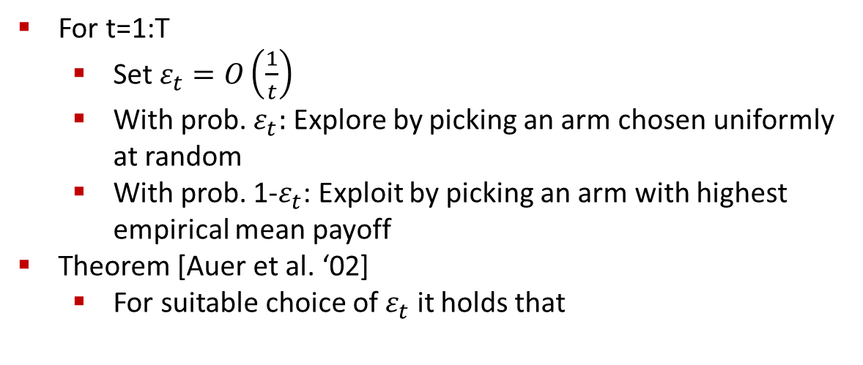
$ε$-Greedy Algorithm
For t=1:T
Set $ε_{t}=O\left(\frac{1}{t}\right)$
With prob. $ε_{t}:$ Explore by picking an arm chosen uniformly at random
With prob. 1-$ε_{t}$: Exploit by picking an arm with highest empirical mean payoff
Theorem [Auer et al. ‘02]
For suitable choice of $ε_{t}$ it holds that

Slide 25

Issues with $ε$-Greedy Algorithm
“Not elegant” : Algorithm explicitly distinguishes between exploration and exploitation
More importantly: Exploration makes suboptimal choices(since it picks any arm equally likely)
Idea: When exploring/exploiting we need to compare arms.
Notes:
Suboptimal solution

Slide 26
Example : Comparing Arms
Suppose we have done experiments :
Arm 1: 1 0 0 1 1 1 0 0 0 1
Arm 2: 1
Arm 3: 1 1 0 1 0 0 1 1 1 1
Mean arm values:
Arm 1: 5/10 Arm 2: 1 Arm 3: 7/10
Which arm would you choose next?
Idea: Not only look at the mean but also the confidence!

Slide 27
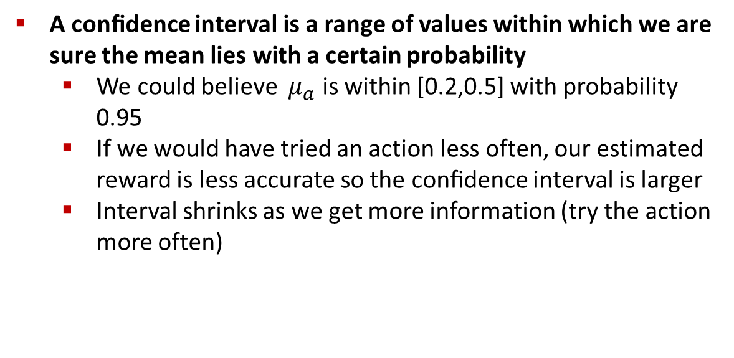
Confidence Intervals
A conﬁdence interval is a range of values within which we are sure the mean lies with a certain probability
We could believe ${ μ}_{a}$ is within [0.2,0.5] with probability 0.95
If we would have tried an action less often, our estimated reward is less accurate so the conﬁdence interval is larger
Interval shrinks as we get more information (try the action more often)

Slide 28
Confidence Intervals
Assuming we know the confidence intervals
Then, instead of trying the action with the highest mean we can try the action with the highest upper bound on its confidence interval.

Slide 29
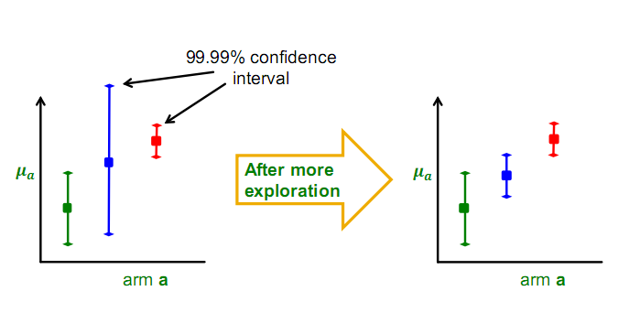
Confidence Based Selection
Notes:
UCB’s strategy for balance the tradeoff of exploration and exploitation is trying the action with the highest upper bound on its confidence interval. The confidence Interval shrinks as we get more information (try the action more often)

Slide 30
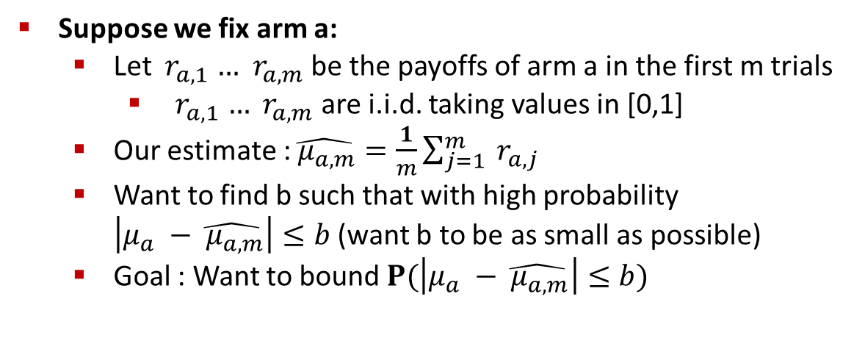
Calculating Confidence Bounds
Suppose we fix arm a:
Let ${ r}_{a,1} …$ ${ r}_{a,m}$ be the payoffs of arm a in the first m trials
${ r}_{a,1} …$ ${ r}_{a,m}$ are i.i.d. taking values in [0,1]
Our estimate :$\hat{{ μ}_{a,m}}=\frac{1}{m}\sum_{j=1}^{m}{{ r}_{a,j}}$
Want to find b such that with high probability $\left|μ_{a} −\hat{{ μ}_{a,m}}\right|≤b$ (want b to be as small as possible)
Goal : Want to bound $P(\left|μ_{a} −\hat{{ μ}_{a,m}}\right|≤b)$

Slide 31
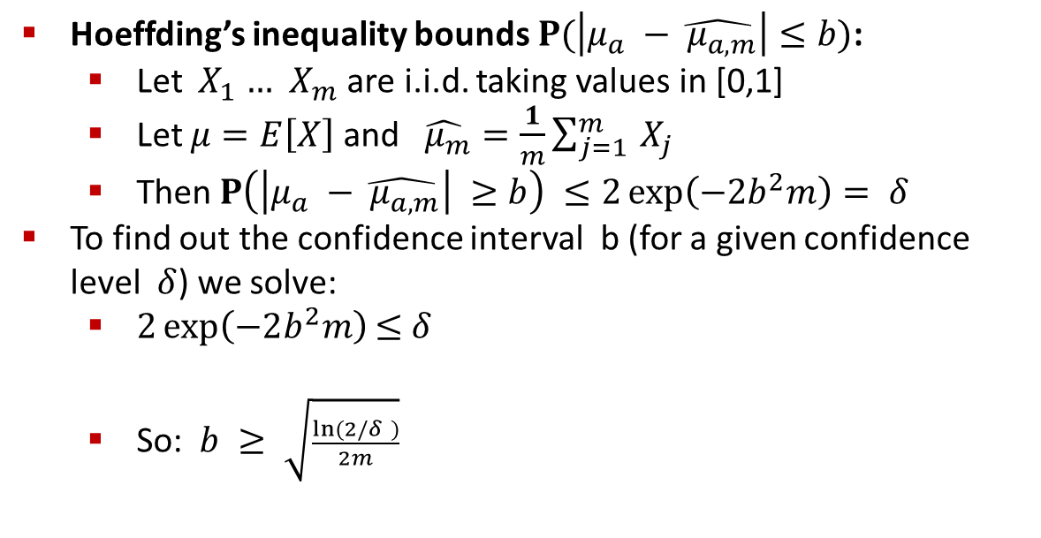
Hoeffding’s Inequality
Hoeffding’s inequality bounds$P(\left|μ_{a} −\hat{{ μ}_{a,m}}\right|≤b)$:
Let ${ X}_{1} …$ ${ X}_{m}$ are i.i.d. taking values in [0,1]
Let $μ=E\left[X\right]$ and $\hat{{ μ}_{m}}=\frac{1}{m}\sum_{j=1}^{m}{{ X}_{j}}$
Then $P\left(\left|μ_{a} −\hat{{ μ}_{a,m}}\right| ≥b\right) ≤2\exp\left(−2b^{2}m\right)= δ$
To find out the confidence interval b (for a given confidence level $δ$) we solve:
$2\exp\left(−2b^{2}m\right)$ $≤$ $δ$
So: $b ≥ \sqrt{\frac{ln⁡(2/δ )}{2m}}$

Slide 32
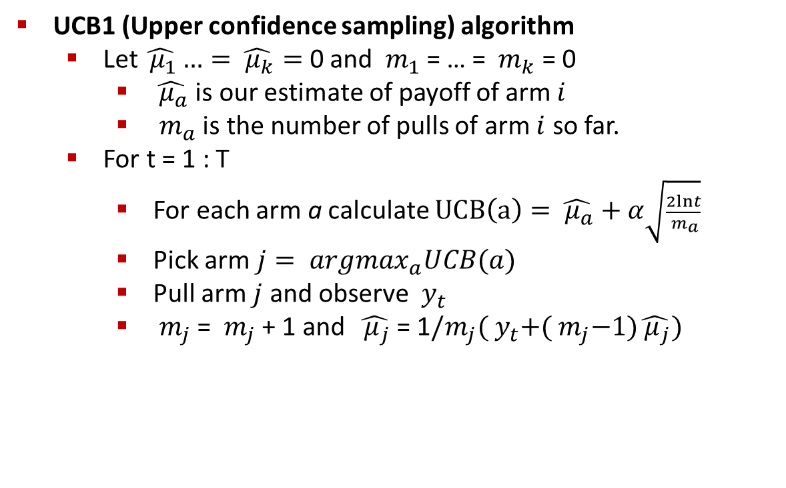
UCB1 Algorithm
UCB1 (Upper confidence sampling) algorithm
Let $\hat{{ μ}_{1}}…=\hat{{ μ}_{k}}=$ 0 and ${ m}_{1}$ = … = ${ m}_{k}$ = 0
$\hat{{ μ}_{a}}$ is our estimate of payoff of arm $i$
${ m}_{a}$ is the number of pulls of arm $i$ so far.
For t = 1 : T
For each arm a calculate $UCB\left(a\right)=\hat{{ μ}_{a}}+α\sqrt{\frac{2lnt}{{ m}_{a}}}$
Pick arm $j= {argmax}_{a}UCB(a)$
Pull arm $j$ and observe ${ y}_{t}$
${ m}_{j}$ = ${ m}_{j}$ + 1 and $\hat{{ μ}_{j}}$ = 1$/m_{j}({ y}_{t}+({ m}_{j}−1)\hat{{ μ}_{j}})$

Slide 33
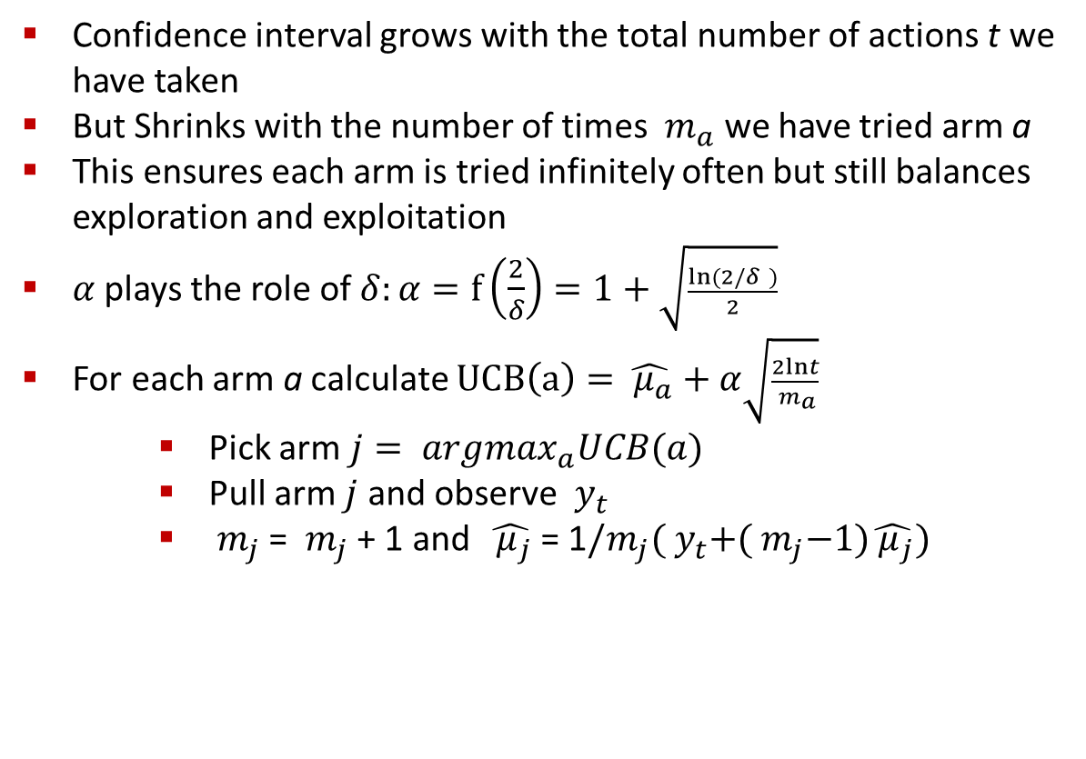
UCB1 Algorithm: Discussion
Confidence interval grows with the total number of actions t we have taken
But Shrinks with the number of times ${ m}_{a}$ we have tried arm a
This ensures each arm is tried infinitely often but still balances exploration and exploitation
$α$ plays the role of $δ:α=f\left(\frac{2}{δ}\right)=1+\sqrt{\frac{ln⁡(2/δ )}{2}}$
For each arm a calculate $UCB\left(a\right)=\hat{{ μ}_{a}}+α\sqrt{\frac{2lnt}{{ m}_{a}}}$
Pick arm $j= {argmax}_{a}UCB(a)$
Pull arm $j$ and observe ${ y}_{t}$
${ m}_{j}$ = ${ m}_{j}$ + 1 and $\hat{{ μ}_{j}}$ = 1$/m_{j}({ y}_{t}+({ m}_{j}−1)\hat{{ μ}_{j}})$

Slide 34


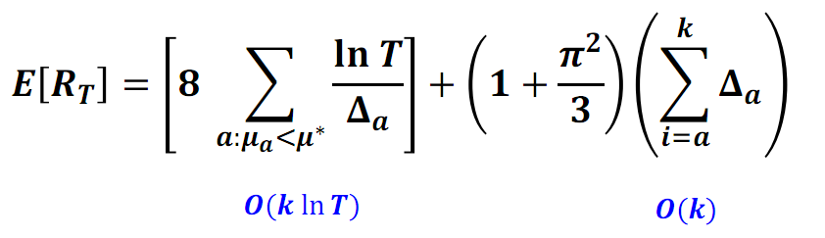

UCB1 Algorithm Performance
Theorem [Auer et al. 2002]
Suppose optimal mean payoff is
And for each arm let
Then it holds that
So, we get

Slide 35
Results

Slide 36

Empirical Results
Scenario
4.7m events(featured article, infos, click) in tuning set
36m events in test set
Articles and Users clustered into 5 categories

Slide 37
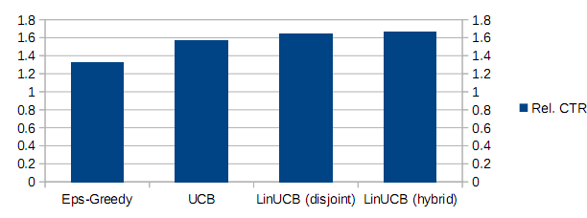
Empirical Results
Results

Slide 38


